Slide 1
Data Science Final Project
Kelvin Bian, Krishaan Chaudhary, Kishan Patel

Slide 2

Dataset - Amazon Luxury Beauty
Perfume
Cologne
Makeup
Foundation
Brush
Skincare products

Slide 3


Approach: Item-Item Collaborative Filtering
Justification:
In e-commerce, items more stable than users
Users tastes - always changing
Items remain constant
Determine Item signatures based on ratings in User-Item Matrix
For a specific item
determine similar items rated by user
predict rating as weighted sum of ratings of similar items rated by user

Slide 4
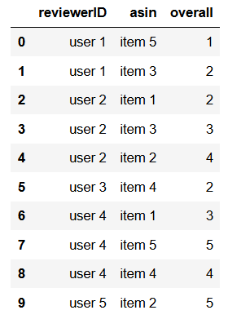
Step 1: Data Preprocessing
DataFrame of only relevant metrics and identifiers
asin - product ID, reviewerID, overall - rating
Group data by reviewerID
Set random seed
reproducibility of results

Slide 5
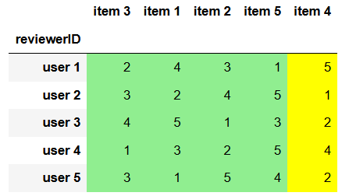
Step 1: Data Preprocessing
User - Item Matrix
Split into:
train set - 80%
test set - 20%
Split procedure:
randomly shuffle each users reviews and selects the first 80%
empty entries are treated as 0

Slide 6

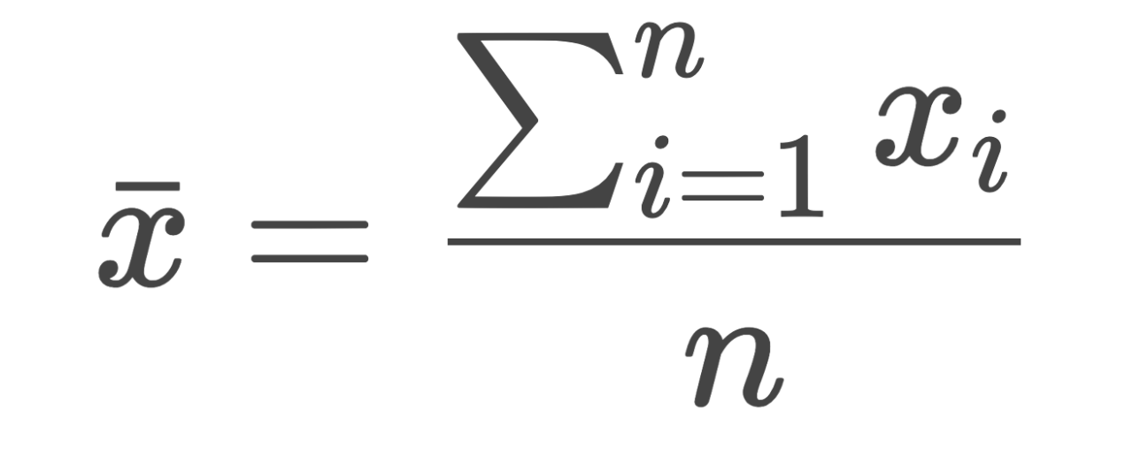
Step 1: Data Preprocessing
Amazon allows 1 review per transaction
User u can buy item i multiple times
1 review for each transaction
Average all of u’s ratings across all reviews for item i
Result: 1 number for each user-item pair

Slide 7
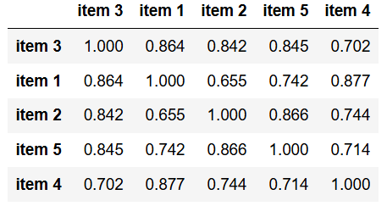
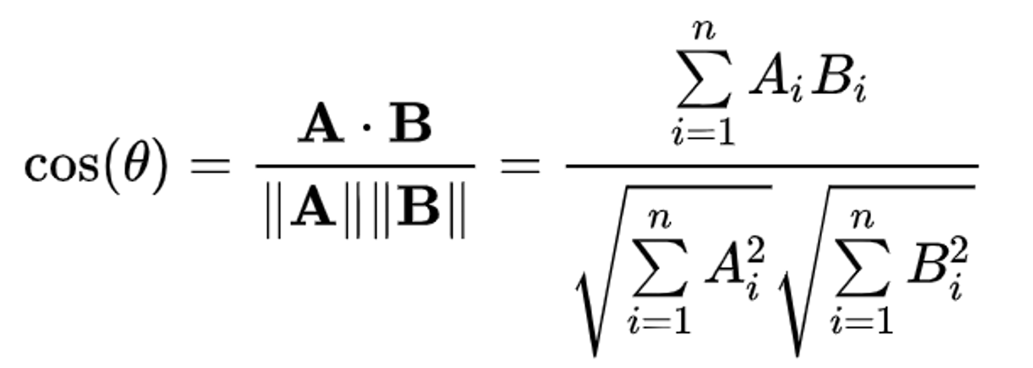
Step 2: Item-Item Collaborative Filtering
Compute an Item-Item Similarity Matrix
Cosine Similarity

Slide 8

Step 2: Item-Item Collaborative Filtering
Make predictions on test set
For each (user u, item i) that needs a prediction:
Choose k most similar items to i
k = 5
Compute weighted average of the ratings of those similar items
more similar items weighed more
Predict weighted average as rating

Slide 9

Step 3: Prediction Evaluation
Once the predictions are made,
Goal: Evaluate effectiveness
Mean Absolute Error (MAE): 0.264
Root Mean Squared Error (RMSE): 0.663
Actual Rating: 5.0
Predicted Rating: 4.82
(User u, Item i)

Slide 10




Step 4: Item Recommendation
Using the information derived from item-item collaborative, filtering
make recommendations for each user
suggest 10 items that have highest predicted ratings
You may also like:

Slide 11
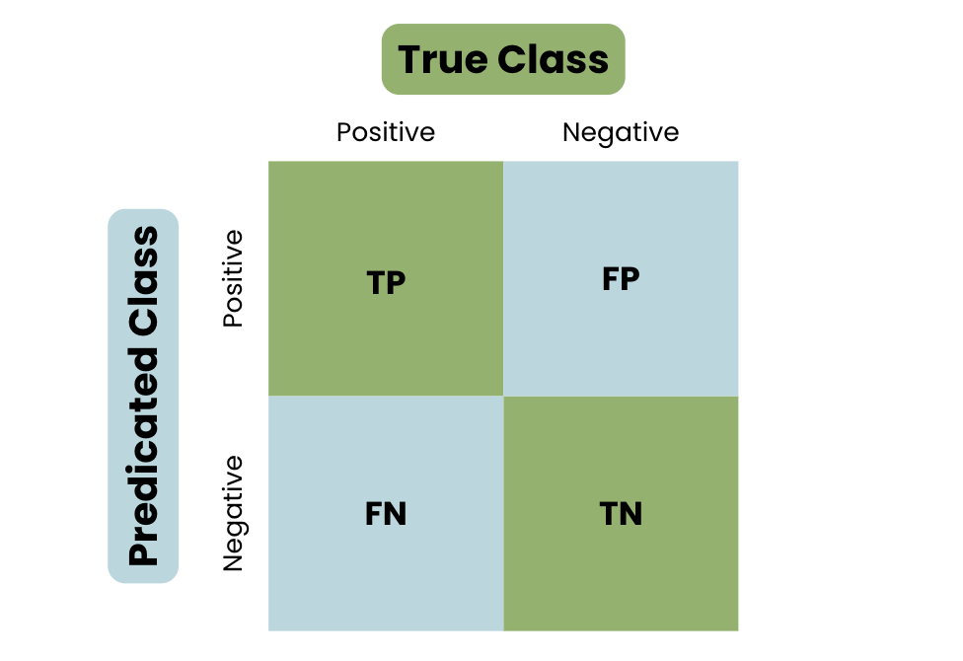

Step 5: Recommendation Evaluation
Calculate metrics to determine effectiveness of recommendations
Precision: 0.11461258450338015
Recall: 0.8420331575167769
F-measure: 0.20176245433705411
NDCG: 0.7132161489988544

Slide 12
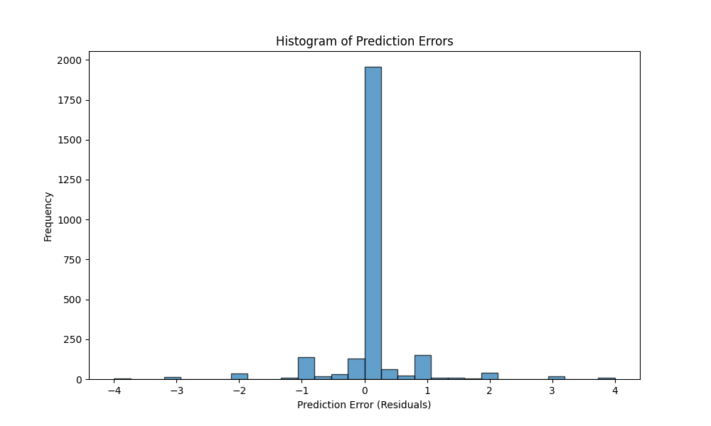
Prediction Error - Item-Item Collaborative Filtering

Slide 13
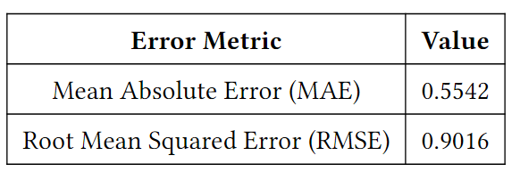
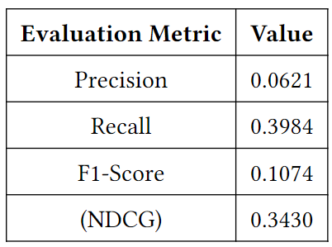
Further Exploration: Baseline
Cold Start Problem
Baseline
Global mean + user deviation + item deviation
Results
Worse overall performance in terms of error metrics
Better coverage

Slide 14
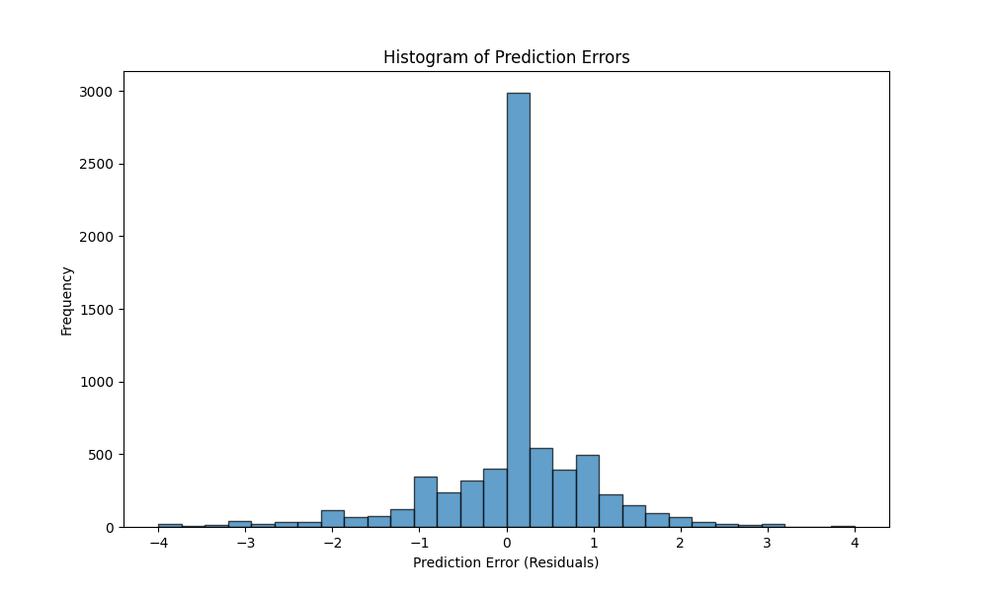
Prediction Error - Item-Item CF With Baseline

Slide 15
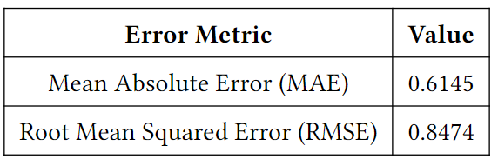
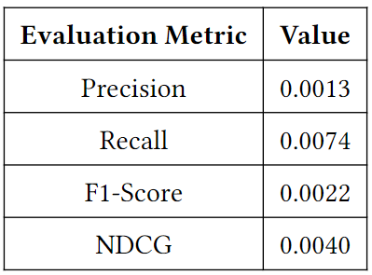
Further Exploration: SVD Matrix Factorization
Cold Start Problem
Baseline
Matrix factorization using Singular Value Decomposition (SVD) to capture latent factors
Results
Worse overall performance in terms of error metrics (higher MAE and RMSE).
Significantly lower recommendation metrics (Precision, Recall, F1-Score, NDCG) compared to item-item CF and content-based models.
Dataset sparsity and overfitting likely contributed to poor performance.

Slide 16
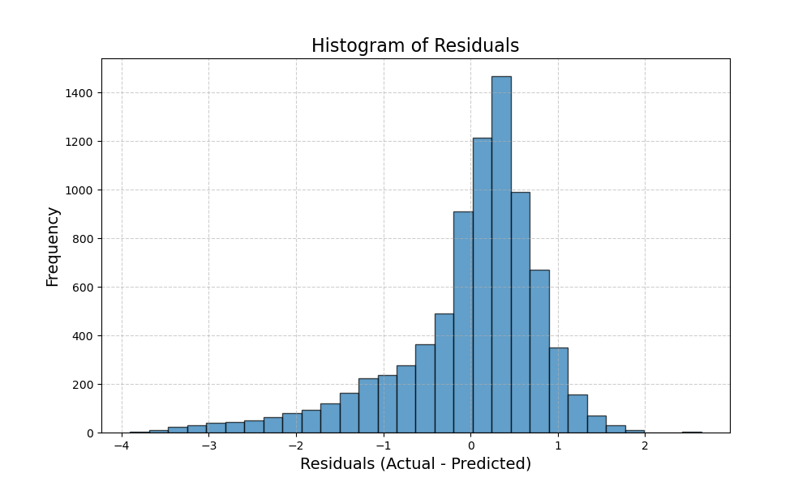
Prediction Error - SVD

Slide 17
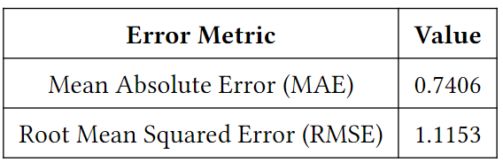
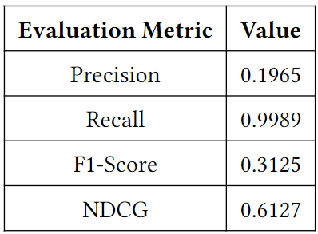
Further Exploration: Content-Based Recommendation
Underrating Problem
Underrated items significantly, with many negative residual outliers; effective for ranking items despite rating prediction challenges.
Baseline
Utilizes review and style data to predict user preferences and generate recommendations.
Results
Higher MAE and RMSE than item-item CF, indicating lower rating prediction accuracy.
Better recommendation metrics (higher Precision and competitive NDCG).
High recall suggests strong ability to retrieve relevant items.
Challenges in modeling exact ratings due to reliance on textual data but effective for generating recommendations.

Slide 18
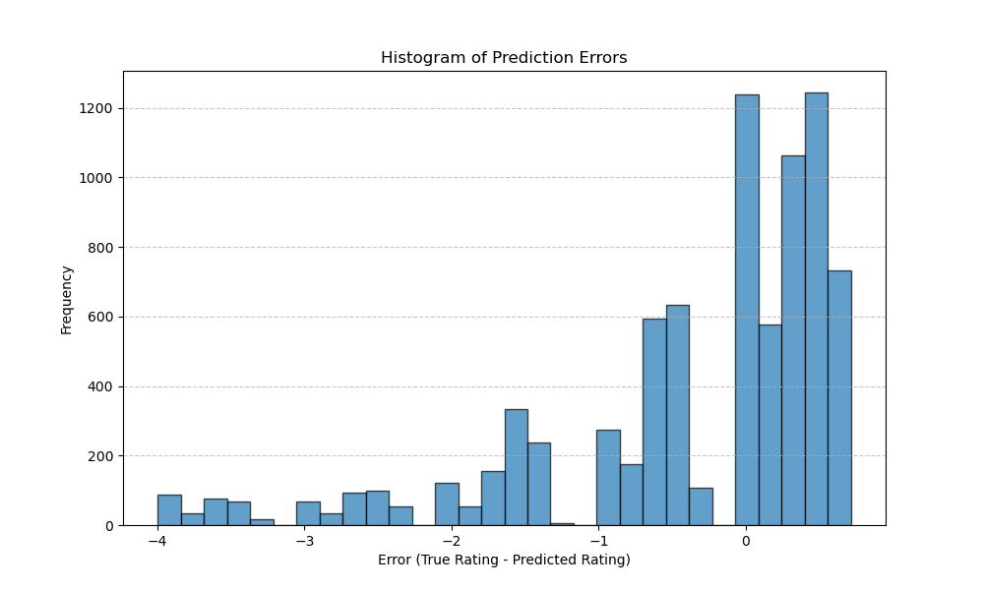
Prediction Error - Content-Based

Slide 19
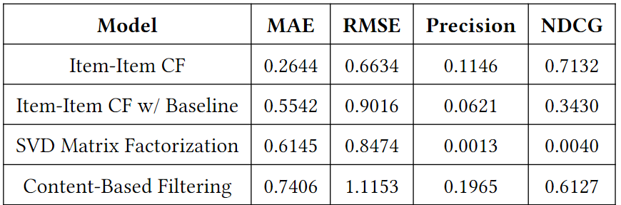
Conclusion: Overall Comparison
Item-Item CF: Achieved the lowest MAE and RMSE, demonstrating the highest rating prediction accuracy.
Content-Based Model: Higher MAE and RMSE but excelled in precision and recall, effective for relevant recommendations.
SVD Model: Poor performance in both prediction accuracy and recommendation metrics, likely due to dataset sparsity and latent factor challenges.
Item-Item CF with Baseline: Improved coverage but compromised accuracy.

